Slide 1

GENESIS 3
THREE LESSONS OF TEMPTATION
GOD
SATAN
HUMANS

Slide 2
创世纪 3
关于“诱惑”的三节课
天主
撒殚
人

Slide 3
Jesus, we enthrone You We proclaim You are king Standing here in the midst of all We raise You up with our praise
And as we worship, fill the throne And as we worship, fill the throne And as we worship, fill the throne Come Lord Jesus and take Your place

Slide 4
耶稣，我们立祢为王， 我们宣告你是王。 祢在我们中间， 我们高举祢，赞美祢。
当我们赞美祢时，请祢登上宝座， 当我们赞美祢时，请祢登上宝座， 当我们赞美祢时，请祢登上宝座， 来吧，主耶稣，请祢登上祢的宝座。

Slide 5
WHERE ARE YOU TODAY?

Slide 6
今天我们在哪里？

Slide 7

1. Now the serpent was more subtle than any other wild creature that the LORD God had made. He said to the woman, "Did God say, `You shall not eat of any tree of the garden’?”
2. And the woman said to the serpent, "We may eat of the fruit of the trees of the garden;
3. but God said, `You shall not eat of the fruit of the tree which is in the midst of the garden, neither shall you touch it, lest you die.'"

Slide 8
在上主天主所造的一切野兽中，蛇是最狡猾的。蛇对女人说："天主真说了，你们不可吃乐园中任何树上的果子吗？“
女人对蛇说："乐园中树上的果子，我们都可吃；
只有乐园中央那棵树上的果子，天主说过，你们不可以吃，也不可摸，免得死亡。"

Slide 9
1. WHO IS GOD? What did God say?

Slide 10
1. 天主是谁？ 天主说了什么？

Slide 11
16 And the Lord God commanded the man, saying, “
You may surely eat of every tree of the garden,
17 but of the tree of the knowledge of good and evil ^{l}you shall not eat, for in the day that you eat ¹ of it you ^{m}shall surely die.”

Slide 12
16上主天主给人下令说："
乐园中各树上的果子，你都可吃，
17只有知善恶树上的果子你不可吃，因为那一天你吃了，必定要死。"

Slide 13
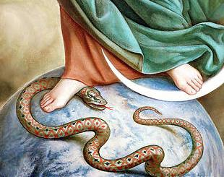
2. Who is the devil? What is the devil saying?

Slide 14
2. 魔鬼（撒殚）是谁？ 魔鬼（撒殚）说了什么？

Slide 15
Now the serpent was more subtle than any other wild creature that the LORD God had made.
He said to the woman, "Did God say, `You shall not eat of any tree of the garden’?”

Slide 16
在上主天主所造的一切野兽中，蛇是最狡猾的。
蛇对女人说："天主真说了，你们不可吃乐园中任何树上的果子吗？"

Slide 17
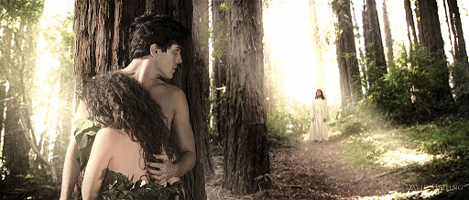
WHERE ARE YOU TODAY?

Slide 18
今天你在哪里呢？

Slide 19
Who am I? What do I want? Where am I?

Slide 20
我是谁？ 我要什么？ 我在哪里？

Slide 21
And they heard the sound of the LORD God walking in the garden in the cool of the day, and the man and his wife hid themselves from the presence of the LORD God among the trees of the garden.
But the LORD God called to the man, and said to him, "Where are you?"

Slide 22
当亚当和他的妻子听见了上主天主趁晚凉在乐园中散步的声音，就躲藏在乐园的树林中，怕见上主天主的面。
上主天主呼唤亚当对他说："你在哪里？"

Slide 23
WHAT IS MY RESPONSE? Who am I? What do I want? Where am I?

Slide 24
我的回答是什么？ 我是谁？ 我要什么？ 我在哪里？

Slide 25
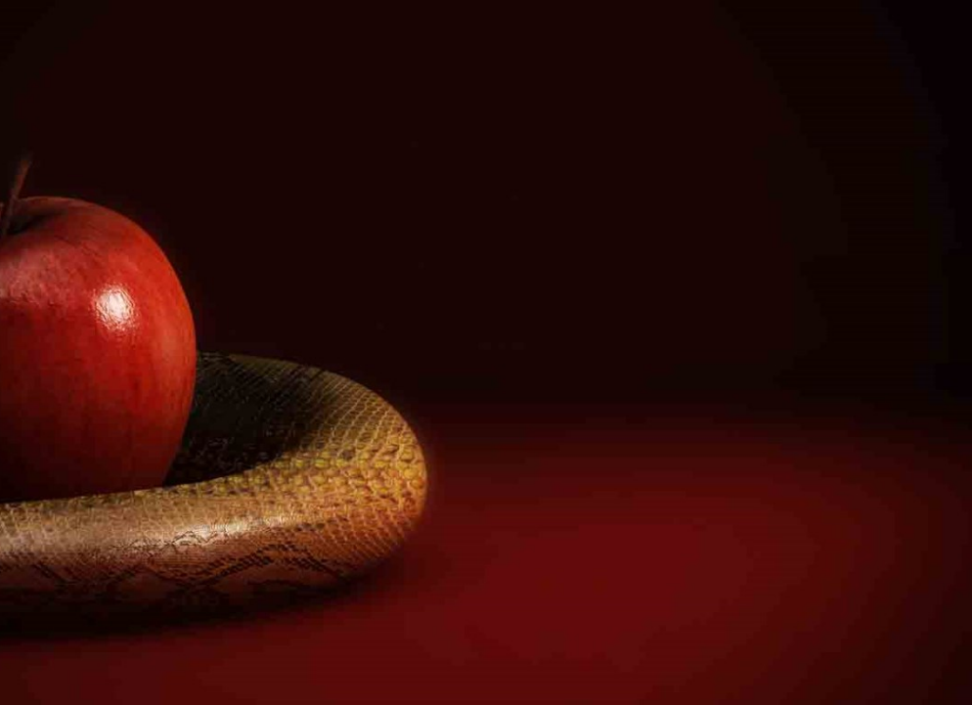
WHAT IS OUR RESPONSE
The man said, "The woman whom thou gavest to be with me, she gave me fruit of the tree, and I ate."
Then the LORD God said to the woman, "What is this that you have done?" The woman said, "The serpent beguiled me, and I ate."

Slide 26
我们的回答是什么？
亚当说："是你给我作伴的那个女人给了我那树上的果子，我才吃了。“
上主天主遂对女人说："你为什么作了这事？"女人答说："是蛇哄骗了我，我才吃了。"

Slide 27
The Subtle Battles of Temptation
Adam and Eve
The Serpent
The Tree of Knowledge

Slide 28
微妙的诱惑之争
亚当和厄娃
蛇
知善恶树

Slide 29

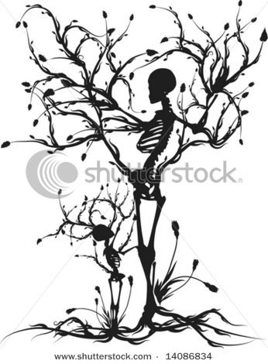
STRATEGY OF SATAN
The Subtle Battles of Temptation (Gen 3:1-5)

Slide 30
撒殚的策略
微妙的诱惑之争 (创世纪 3:1-5)

Slide 31
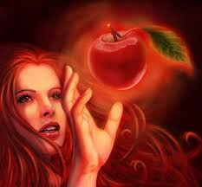
EDEN
Fruit was good for food
Delight to the eyes
Desire to make one wise
TEMPTATION
BODY
SOUL
MIND
DESERT
Turn stone into bread
Sensational jump to see
Give you all the kingdoms

Slide 32
伊甸园
Fruit was good for food
Delight to the eyes
Desire to make one wise
诱惑
BODY
SOUL
MIND
流落旷野时
Turn stone into bread
Sensational jump to see
Give you all the kingdoms

Slide 33
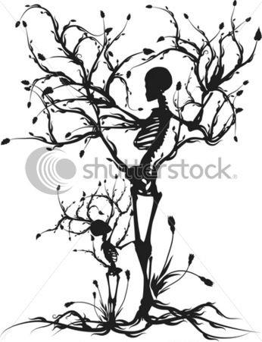
Tree of Knowledge of good and evil If you eat… you will die (2:15; 3:3)
How does this take place?
The Strategy
Create doubt
Spirituality
Spiritual Attack
The Questions
Where/what
Consequence
Cursed
The Lessons
Death and Life
What is the process of death and life?
Know what God said
Food-eyes-knowledge
Acknowledgment of sin
Sin leads to suffering
Two trees- Life and death

Slide 34

Reflection on TEMPTATION :
In what particular way is God calling you to obedience
Study each subtle battle of temptation in your life.
The Strategy (1-5)
The Spirituality (6-7)
The Questions (8-13)
The Consequence (14-20)
The Lessons of Temptation (21-24)

